Slide 1


ZOMATO RESTAURANT ANALYSIS
By - NEERAJ BITRA
11/02/2024

Slide 2

About the Project
1
Identify high-demand areas for new restaurants.
2
Understand trends in popular cuisines and menu preferences.
Zomato strategically analyzes data to identify areas with high demand for new restaurants.
Zomato collects and analyzes data to stay updated on the latest trends in cuisines and menu preferences.
3
Recommend data-driven strategies for efficient operations and improved customer experience.
Zomato uses data insights to provide recommendations for optimizing restaurant operations and enhancing customer experience.

Slide 3

1
Zomato is a popular online food delivery and restaurant discovery platform.
2
Convenient and efficient way to satisfy food cravings.
It operates in multiple countries across the globe and provides users with a wide range of options from various cuisines.
Zomato's user-friendly interface and extensive database make it a go-to platform for people seeking a convenient and efficient way to order from nearby restaurants.

Slide 4
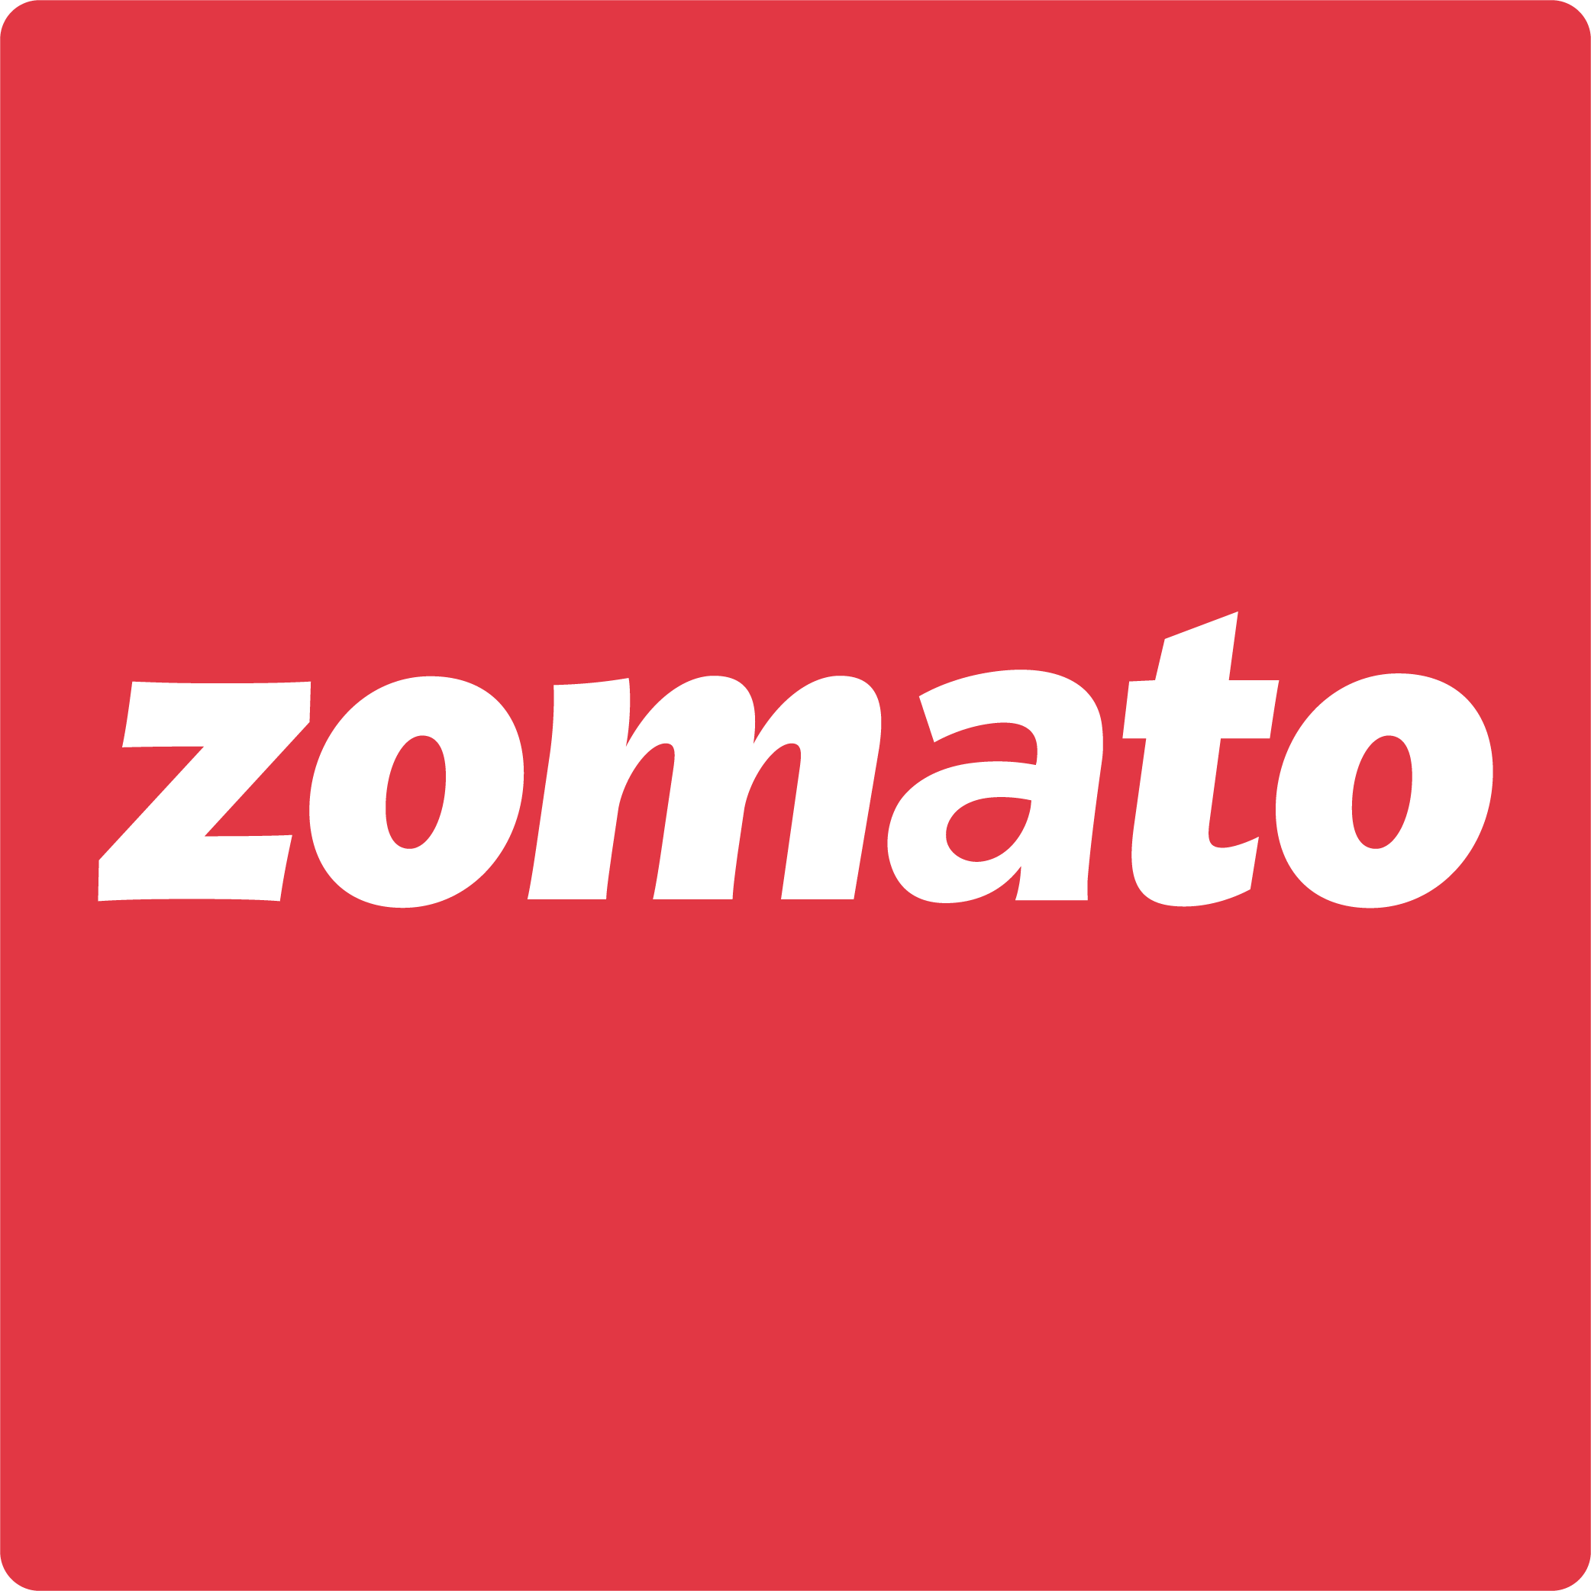

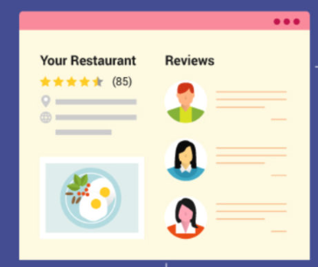
Data Overview
Data Sources: Here, in this provided source of raw data Raw Data of the spreadsheet link
Data Cleaning: I have corrected the spelling mistakes, filled in the missing data cells, and cleaned up the document.
Key Data Points:
According to the provided data, major restaurants are most present in India, and the USA by an average of 8652 and 483.
Arrange tabular forms for restaurant functions and work modes with prize range and ratings.
Data Importance: Enables analysis of market demand, customer preferences, and operational needs.

Slide 5
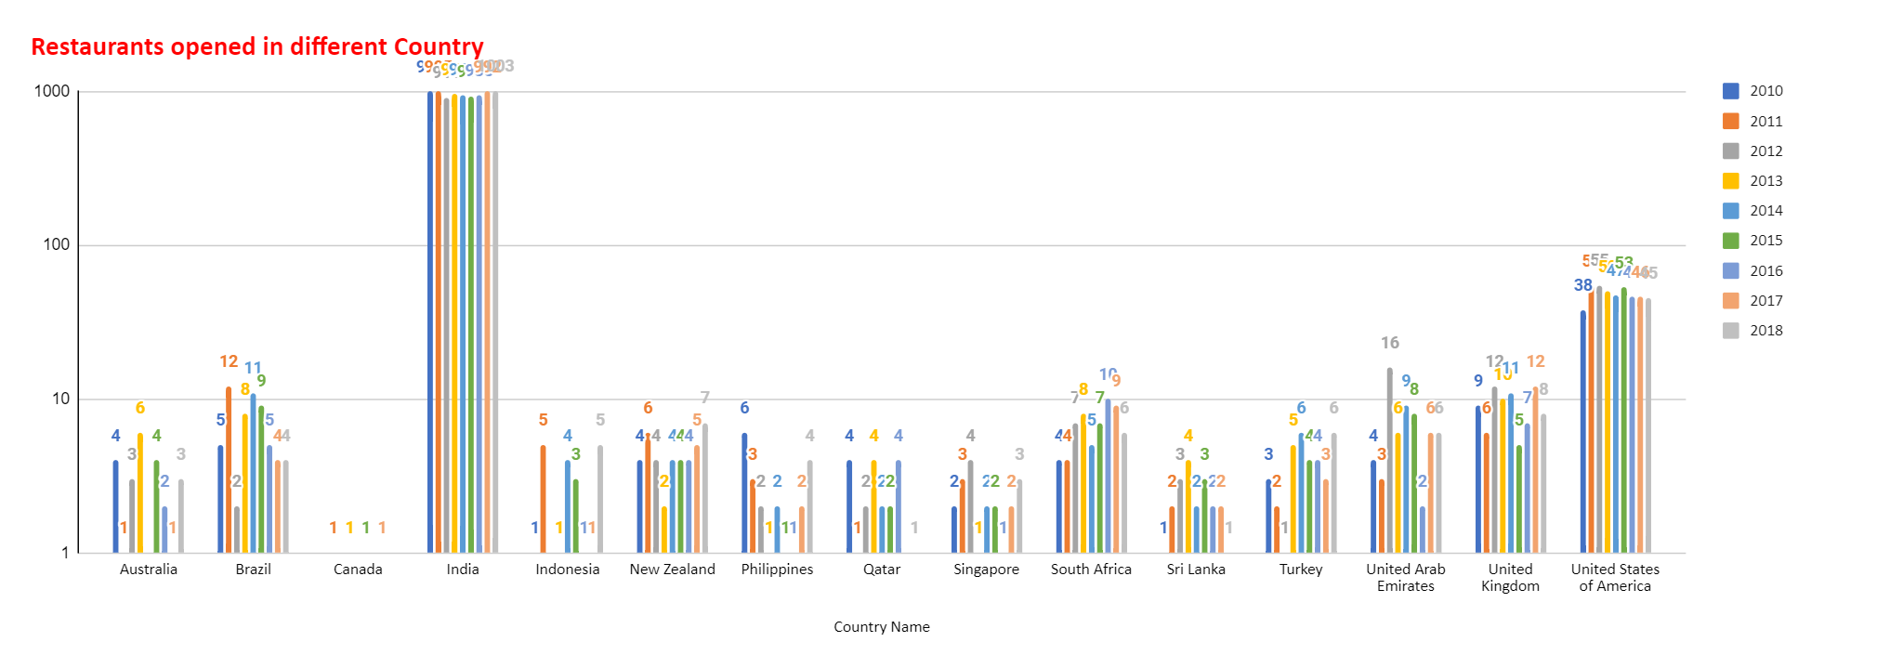
The text seems to be clear and grammatically correct. However, it's not a complete sentence. It appears to be a request or an instruction to remember specific information about a chart that shows data on restaurants opened in different countries.
“New Zealand, Philippines and Turkey have much more Rating and currency in restaurants compared to other countries.“
" New Zealand, Philippines and Turkey have a strategic opportunity to open new restaurants.“

Slide 6
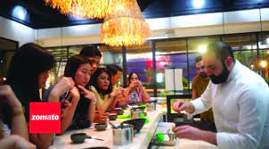



Suggestions and strategies for Zomato to open new restaurants
Identifying Market Opportunities
High-Demand Areas:
Map highlighting potential locations based on user data, delivery trends, and demographics.
Analyses areas with unmet demand for specific cuisines or dining experiences.
Understanding Competition:
Competitive landscape analysis: Comparing pricing, menu offerings, and customer reviews.
Identifying unique selling points for new Zomato restaurants.
Delivery Optimization:
Analysing delivery data to identify efficient routes, optimize staff scheduling, and choose suitable delivery partners.

Slide 7
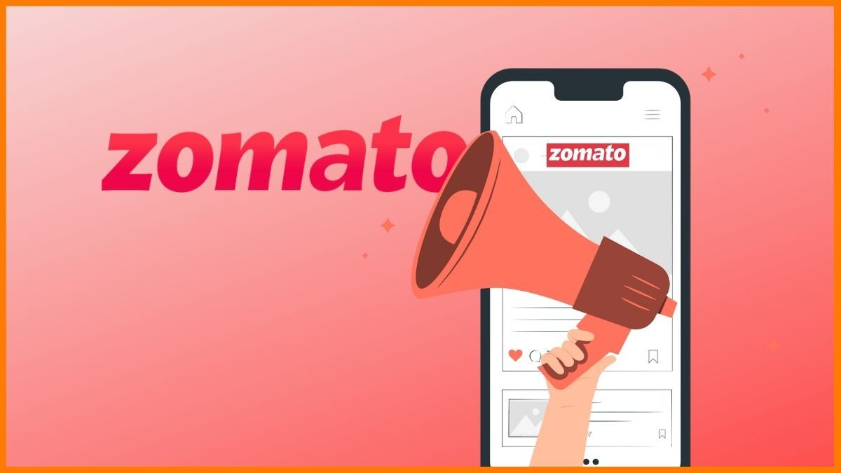
Exploring Opportunities in the Online Food Delivery Market
Did you know that the online food delivery market is projected to reach a staggering $326.72 billion by 2027?
As Zomato expands its restaurant presence, our objective is clear: identify high-demand areas for new restaurants, understand trends in popular cuisines and menu preferences, and recommend data-driven strategies for efficient operations and improved customer experience. Join us on this exciting journey!

Slide 8
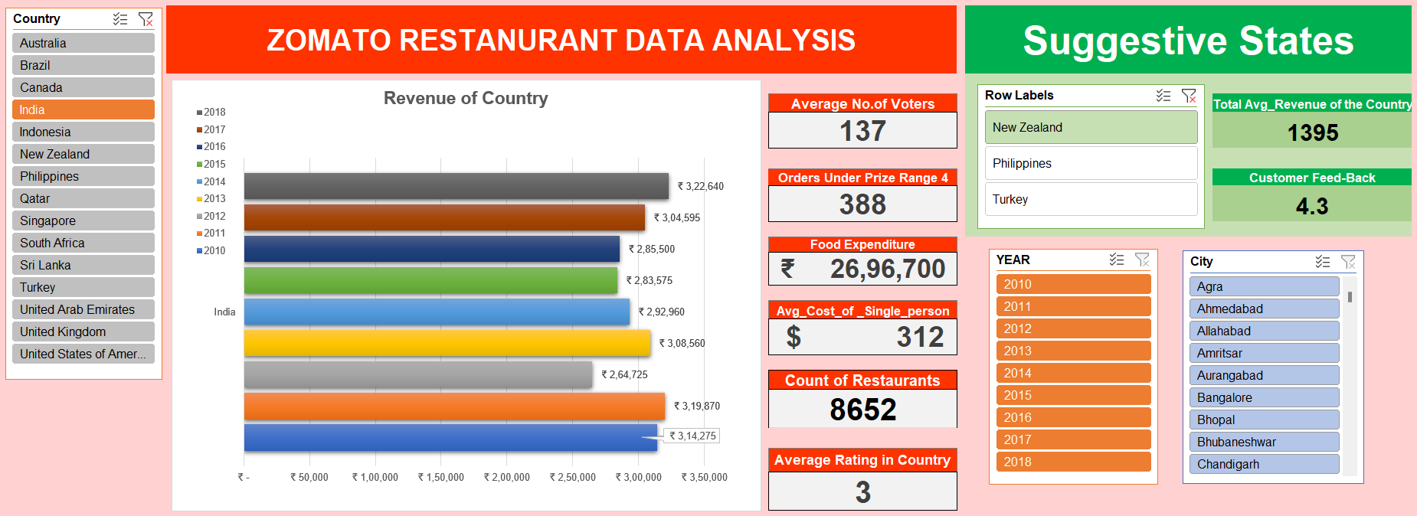
DASHBOARD FOR ZOMATO RESTAURANT IN EXCEL
The analyzed data has been processed and various suggestions and strategies have been generated. These have been posted on GitHub for further reference.

Slide 9
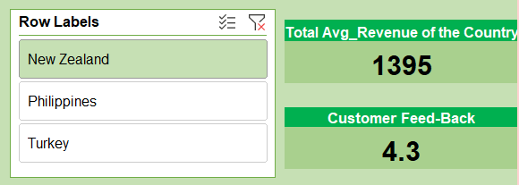
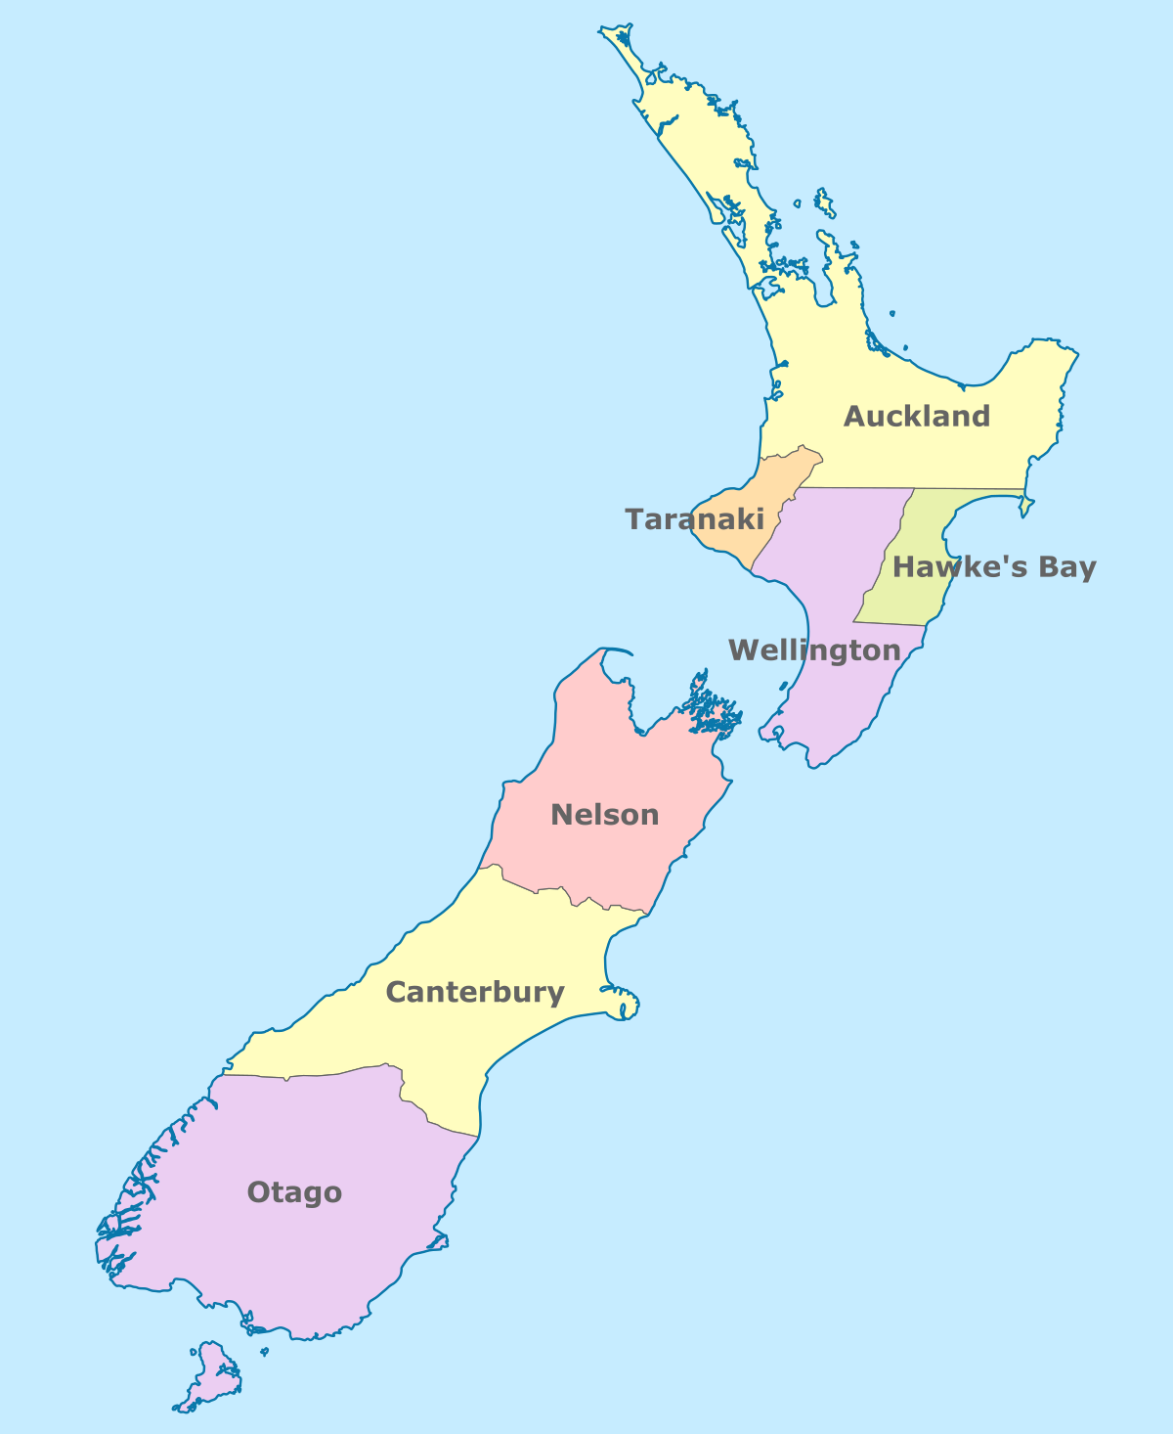
Suggestive Countries Data of Analysis
1. New Zealand
The average expenditure in the country is $1395.
The average voter's feedback for the country is 4.3 out of 5.
An individual can spend up to $35.
There are over 40 restaurants currently operating.
The potential for online delivery and multi-cuisine options also exists.

Slide 10
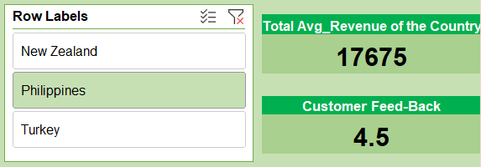
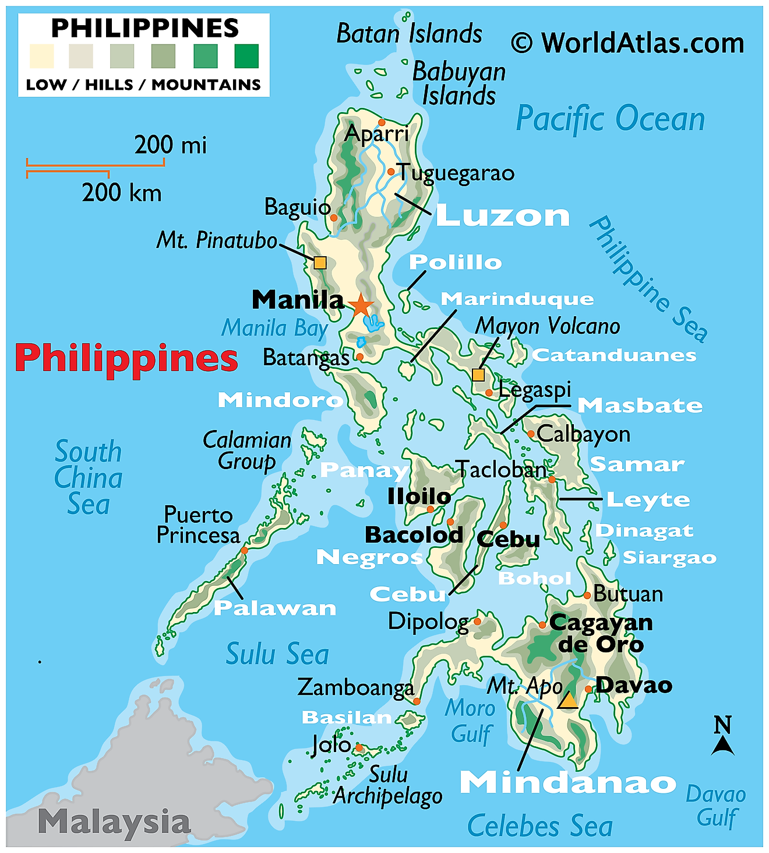
2. Philippines
The average expenditure in the country is $1395.
The average voter's feedback for the country is 4.3 out of 5.
An individual can spend up to $35.
There are over 40 restaurants currently operating.
The potential for online delivery and multi-cuisine options also exists.

Slide 11
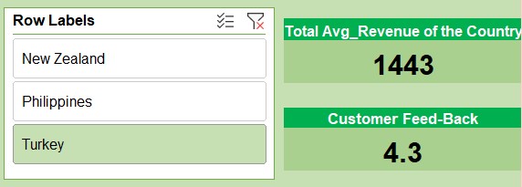
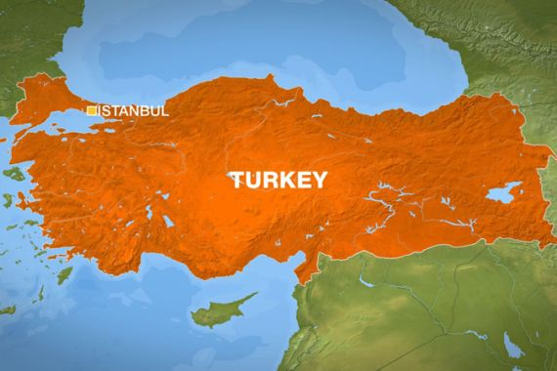
3.Turkey
The average expenditure in the country is $1395.
The average voter's feedback for the country is 4.3 out of 5.
An individual can spend up to $35.
There are over 40 restaurants currently operating.
The potential for online delivery and multi-cuisine options also exists.

Slide 12
Optimal Location Selection for New Restaurants
Community Engagement
Accessibility and Parking
Foot Traffic Analysis
To ensure that the new Zomato restaurants get maximum visibility and accessibility, we need to identify high-traffic areas.
Explore areas with a strong sense of community to foster loyal customer relationships and support local initiatives.
Evaluate locations with convenient parking options and easy access to public transportation to accommodate diverse customer needs.

Slide 13
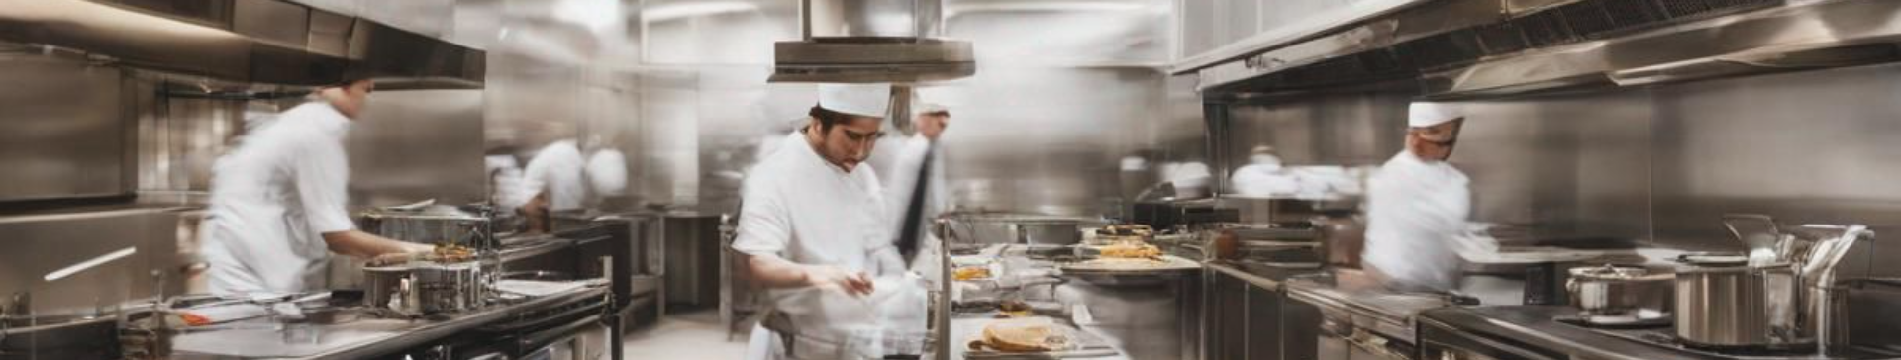
Effective Operational Strategies
1
Streamlined Kitchen Workflow
2
Staff Training and Development
3
Quality Control Measures
Establish stringent quality control protocols to maintain the standard of food and service across Zomato restaurants.
Implement efficient kitchen processes to ensure timely and consistent delivery of high-quality meals.
Invest in comprehensive training programs to equip the staff with the skills and knowledge necessary for exceptional service.

Slide 14
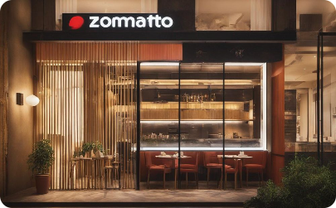
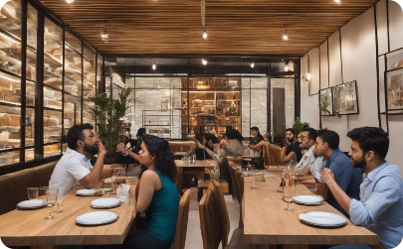
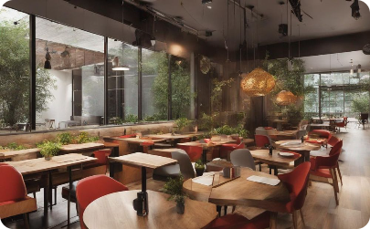
Marketing and Promotion Initiatives
Strategic Signage Placement
Customer Experience Showcases
Digital Marketing Strategies
Utilize eye-catching signage strategically placed to attract and guide potential customers to Zomato restaurants.
Create engaging content showcasing positive customer experiences to drive interest and footfall to the restaurants.
Implement innovative digital campaigns to target and engage with potential customers through various online platforms.

Slide 15

Customer Feedback and Continuous Improvement
1
Feedback Collection
Establish effective systems for collecting and analyzing customer feedback to drive continuous enhancement.
2
Adaptation Strategies
Implement agile adaptation strategies based on customer input to consistently improve the dining experience.
3
Staff Empowerment
Empower the staff to make customer-centric decisions and create a culture of proactive service excellence.

Slide 16
Financial Planning and Management
Financial Performance Analysis
Budget Allocation
Pricing Strategies
Allocate resources effectively while maintaining a focus on quality and value for both customers and stakeholders.
Implement strategic pricing approaches to optimize revenue without compromising customer satisfaction and loyalty.
Regularly analyze financial performance to identify areas for improvement and capitalize on opportunities for growth.

Slide 17
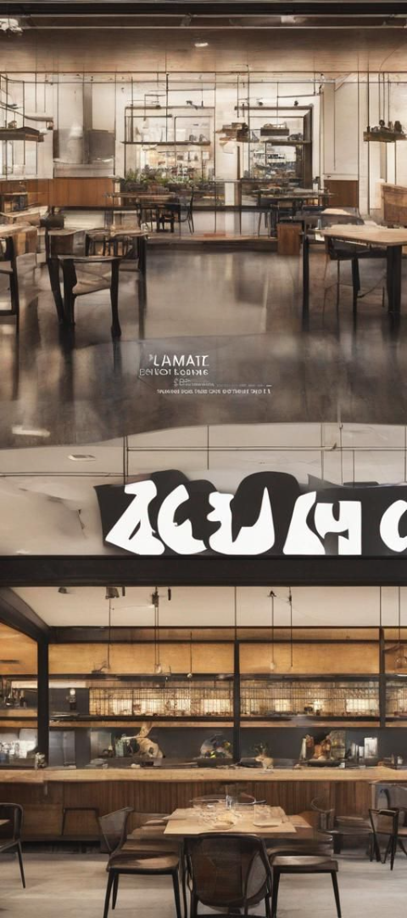



Growth and Expansion Strategy
Scalability Assessment
Assess the potential for scalability and expansion while maintaining the essence and quality of Zomato restaurants.
Strategic Alliances
Explore strategic partnerships and alliances to facilitate smooth and strategic expansions into new locations and markets.
Continuous Innovation
Drive innovation and adaptability to cater to changing consumer preferences and emerging market trends.

Slide 18

References
Newton school's provided Raw Data of ZOMATO
Google Spreadsheet
Google slider for PPT
Google Gemini, Gamma AI tools,.. etc

Slide 19


